Slide 1

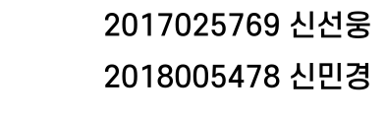

Slide 2










Slide 3





Slide 4








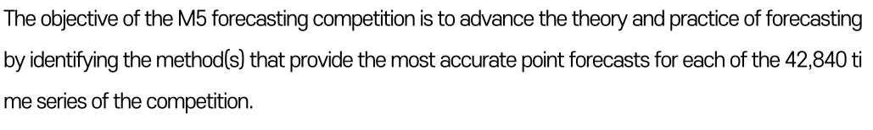

Slide 5

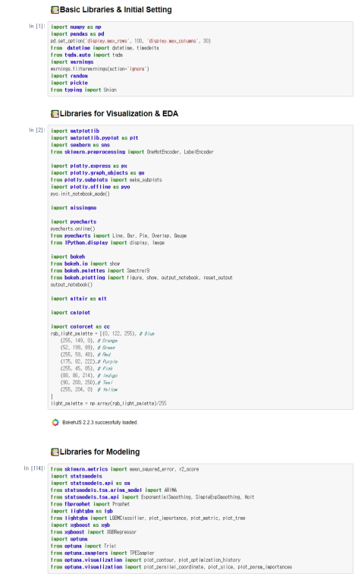




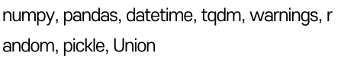



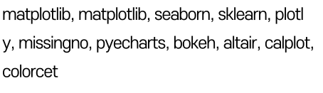


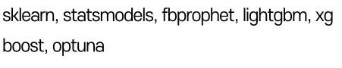

Slide 6

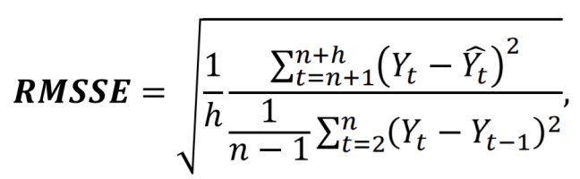


The accuracy of the point forecasts will be evaluated using the Root Mean Squared Scaled Error (RMSSE),
𝑌𝑡 : the actual future value of the examined time series at point t,
𝑌𝑡^ : the generated forecast,
n: the length of the training sample (number of historical observations),
h: the forecasting horizon.
After estimating the RMSSE for all the 42,840 time series of the competition, the participating methods
will be ranked using the Weighted RMSSE (WRMSSE), as described latter in this Guide, using the following
formula:
where 𝑤𝑖 is the weight of the 𝑖𝑡ℎ series of the competition. **A lower WRMSSE score is better**

Slide 7
Code making class for Creating WRMSSE
Code for Visualizing based on WRMSSE
class WRMSSEEvaluator(object):
def __init__(self, train_df: pd.DataFrame, valid_df: pd.DataFrame,
calendar: pd.DataFrame, prices: pd.DataFrame):
train_y = train_df.loc[:, train_df.columns.str.startswith('d_')]
train_target_columns = train_y.columns.tolist()
weight_columns = train_y.iloc[:, -28:].columns.tolist()
train_df['all_id'] = 'all' # for lv1 aggregation
id_columns = train_df.loc[:, ~train_df.columns.str.startswith('d_')]\
.columns.tolist()
valid_target_columns = valid_df.loc[:, valid_df.columns.str.startswith('d_')]\
.columns.tolist()
if not all([c in valid_df.columns for c in id_columns]):
valid_df = pd.concat([train_df[id_columns], valid_df],
axis=1, sort=False)
self.train_df = train_df
self.valid_df = valid_df
self.calendar = calendar
self.prices = prices
self.weight_columns = weight_columns
self.id_columns = id_columns
self.valid_target_columns = valid_target_columns
weight_df = self.get_weight_df()
self.group_ids = (
'all_id',
'state_id',
'store_id',
'cat_id',
'dept_id',
['state_id', 'cat_id'],
['state_id', 'dept_id'],
['store_id', 'cat_id'],
['store_id', 'dept_id'],
'item_id',
['item_id', 'state_id'],
['item_id', 'store_id']
)
for i, group_id in enumerate(tqdm(self.group_ids)):
train_y = train_df.groupby(group_id)[train_target_columns].sum()
scale = []
for _, row in train_y.iterrows():
series = row.values[np.argmax(row.values != 0):]
scale.append(((series[1:] - series[:-1]) ** 2).mean())
setattr(self, f'lv{i + 1}_scale', np.array(scale))
setattr(self, f'lv{i + 1}_train_df', train_y)
setattr(self, f'lv{i + 1}_valid_df', valid_df.groupby(group_id)\
[valid_target_columns].sum())
lv_weight = weight_df.groupby(group_id)[weight_columns].sum().sum(axis=1)
setattr(self, f'lv{i + 1}_weight', lv_weight / lv_weight.sum())
def get_weight_df(self) -> pd.DataFrame:
day_to_week = self.calendar.set_index('d')['wm_yr_wk'].to_dict()
weight_df = self.train_df[['item_id', 'store_id'] + self.weight_columns]\
.set_index(['item_id', 'store_id'])
weight_df = weight_df.stack().reset_index()\
.rename(columns={'level_2': 'd', 0: 'value'})
weight_df['wm_yr_wk'] = weight_df['d'].map(day_to_week)
weight_df = weight_df.merge(self.prices, how='left',
on=['item_id', 'store_id', 'wm_yr_wk'])
weight_df['value'] = weight_df['value'] * weight_df['sell_price']
weight_df = weight_df.set_index(['item_id', 'store_id', 'd'])\
.unstack(level=2)['value']\
.loc[zip(self.train_df.item_id, self.train_df.store_id), :]\
.reset_index(drop=True)
weight_df = pd.concat([self.train_df[self.id_columns],
weight_df], axis=1, sort=False)
return weight_df
def rmsse(self, valid_preds: pd.DataFrame, lv: int) -> pd.Series:
valid_y = getattr(self, f'lv{lv}_valid_df')
score = ((valid_y - valid_preds) ** 2).mean(axis=1)
scale = getattr(self, f'lv{lv}_scale')
return (score / scale).map(np.sqrt)
def score(self, valid_preds: Union[pd.DataFrame,
np.ndarray]) -> float:
assert self.valid_df[self.valid_target_columns].shape \
== valid_preds.shape
if isinstance(valid_preds, np.ndarray):
valid_preds = pd.DataFrame(valid_preds,
columns=self.valid_target_columns)
valid_preds = pd.concat([self.valid_df[self.id_columns],
valid_preds], axis=1, sort=False)
all_scores = []
for i, group_id in enumerate(self.group_ids):
valid_preds_grp = valid_preds.groupby(group_id)[self.valid_target_columns].sum()
setattr(self, f'lv{i + 1}_valid_preds', valid_preds_grp)
lv_scores = self.rmsse(valid_preds_grp, i + 1)
setattr(self, f'lv{i + 1}_scores', lv_scores)
weight = getattr(self, f'lv{i + 1}_weight')
lv_scores = pd.concat([weight, lv_scores], axis=1,
sort=False).prod(axis=1)
all_scores.append(lv_scores.sum())
self.all_scores = all_scores
return np.mean(all_scores)
wrmsse_calendar = pd.read_csv('../../m5-data/calendar.csv')
wrmsse_prices = pd.read_csv('../../m5-data/sell_prices.csv')
wrmsse_sales = pd.read_csv('../../m5-data/sales_train_evaluation.csv')
wrmsse_train_df = wrmsse_sales.iloc[:, :-28]
wrmsse_valid_df = wrmsse_sales.iloc[:, -28:]
evaluator = WRMSSEEvaluator(wrmsse_train_df, wrmsse_valid_df,
wrmsse_calendar, wrmsse_prices)
def create_viz_df(df,lv):
df = df.T.reset_index()
if lv in [6,7,8,9,11,12]:
df.columns = [i[0] + '_' + i[1] if i != ('index','') \
else i[0] for i in df.columns]
df = df.merge(calendar.loc[:, ['d','date']], how='left',
left_on='index', right_on='d')
df['date'] = pd.to_datetime(df.date)
df = df.set_index('date')
df = df.drop(['index', 'd'], axis=1)
return df
def create_dashboard(evaluator):
wrmsses = [np.mean(evaluator.all_scores)] + evaluator.all_scores
labels = ['Overall'] + [f'Level {i}' for i in range(1, 13)]
## WRMSSE by Level
plt.figure(figsize=(12,5))
ax = sns.barplot(x=labels, y=wrmsses)
ax.set(xlabel='', ylabel='WRMSSE')
plt.title('WRMSSE by Level', fontsize=20, fontweight='bold')
for index, val in enumerate(wrmsses):
ax.text(index*1, val+.01, round(val,4), color='black',
ha="center")
# configuration array for the charts
n_rows = [1, 1, 4, 1, 3, 3, 3, 3, 3, 3, 3, 3]
n_cols = [1, 3, 3, 3, 3, 3, 3, 3, 3, 3, 3, 3]
width = [7, 14, 14, 14, 14, 14, 14, 14, 14, 14, 14, 14]
height = [4, 3, 12, 3, 9, 9, 9, 9, 9, 9, 9, 9]
for i in range(1,13):
scores = getattr(evaluator, f'lv{i}_scores')
weights = getattr(evaluator, f'lv{i}_weight')
if i > 1 and i < 9:
if i < 7:
fig, axs = plt.subplots(1, 2, figsize=(12, 3))
else:
fig, axs = plt.subplots(2, 1, figsize=(12, 8))
## RMSSE plot
scores.plot.bar(width=.8, ax=axs[0], color='g')
axs[0].set_title(f"RMSSE", size=14)
axs[0].set(xlabel='', ylabel='RMSSE')
if i >= 4:
axs[0].tick_params(labelsize=8)
for index, val in enumerate(scores):
axs[0].text(index*1, val+.01, round(val,4), color='black',
ha="center", fontsize=10 if i == 2 else 8)
## Weight plot
weights.plot.bar(width=.8, ax=axs[1])
axs[1].set_title(f"Weight", size=14)
axs[1].set(xlabel='', ylabel='Weight')
if i >= 4:
axs[1].tick_params(labelsize=8)
for index, val in enumerate(weights):
axs[1].text(index*1, val+.01, round(val,2), color='black',
ha="center", fontsize=10 if i == 2 else 8)
fig.suptitle(f'Level {i}: {evaluator.group_ids[i-1]}', size=24 ,
y=1.1, fontweight='bold')
plt.tight_layout()
plt.show()
trn = create_viz_df(getattr(evaluator, f'lv{i}_train_df')\
.iloc[:, -28*3:], i)
val = create_viz_df(getattr(evaluator, f'lv{i}_valid_df'), i)
pred = create_viz_df(getattr(evaluator, f'lv{i}_valid_preds'), i)
n_cate = trn.shape[1] if i < 7 else 9
fig, axs = plt.subplots(n_rows[i-1], n_cols[i-1],
figsize=(width[i-1],height[i-1]))
if i > 1:
axs = axs.flatten()
## Time series plot
for k in range(0, n_cate):
ax = axs[k] if i > 1 else axs
trn.iloc[:, k].plot(ax=ax, label='train')
val.iloc[:, k].plot(ax=ax, label='valid')
pred.iloc[:, k].plot(ax=ax, label='pred')
ax.set_title(f"{trn.columns[k]} RMSSE:{scores[k]:.4f}", size=14)
ax.set(xlabel='', ylabel='sales')
ax.tick_params(labelsize=8)
ax.legend(loc='upper left', prop={'size': 10})
if i == 1 or i >= 9:
fig.suptitle(f'Level {i}: {evaluator.group_ids[i-1]}', size=24 ,
y=1.1, fontweight='bold')
plt.tight_layout()
plt.show()

Slide 8

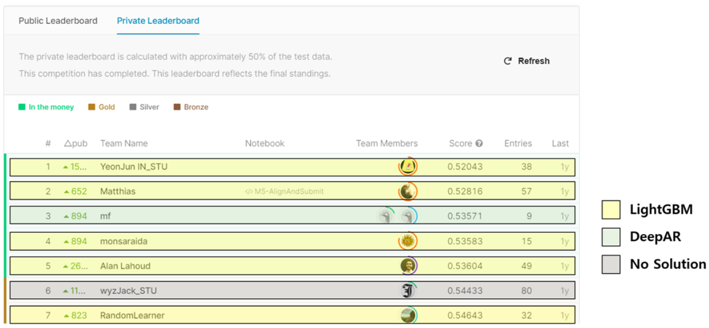

From M5 leaderboard, we can see that LightGBM is good choice

Slide 9




Slide 10



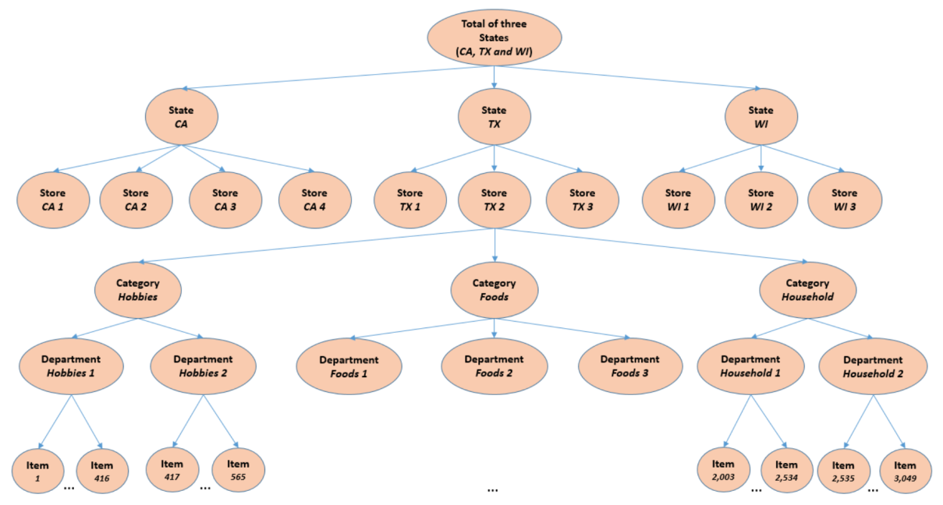


Slide 11

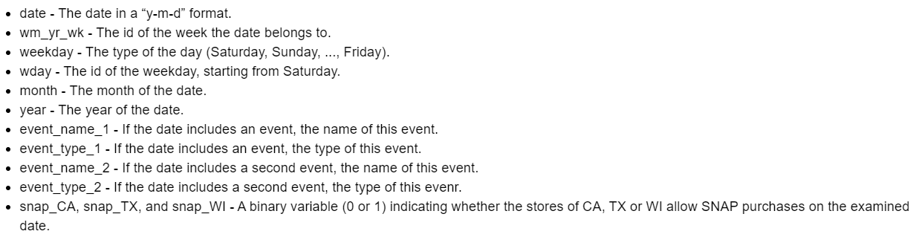

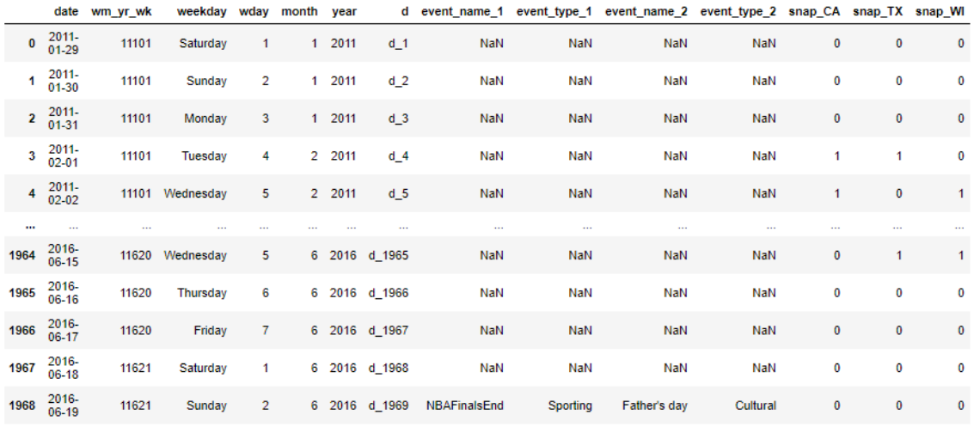

Slide 12

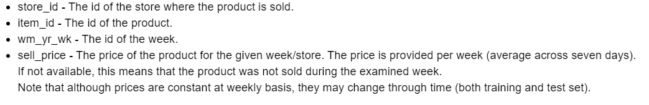
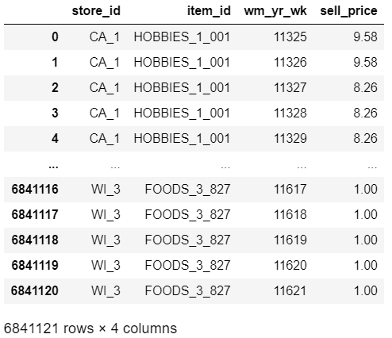

Slide 13

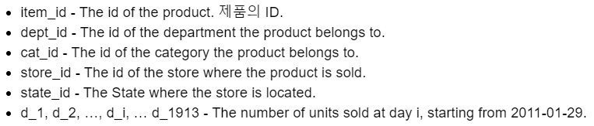
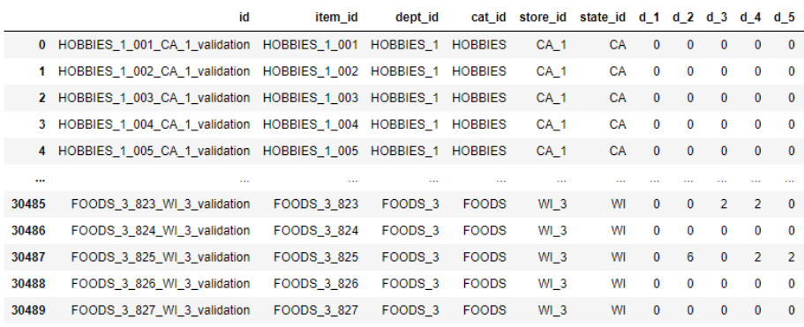
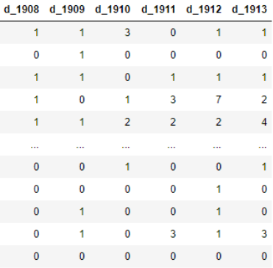

Slide 14


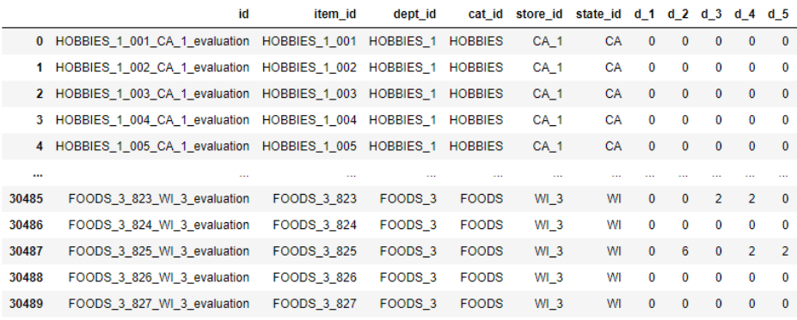
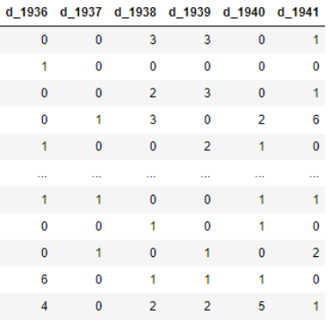

Slide 15

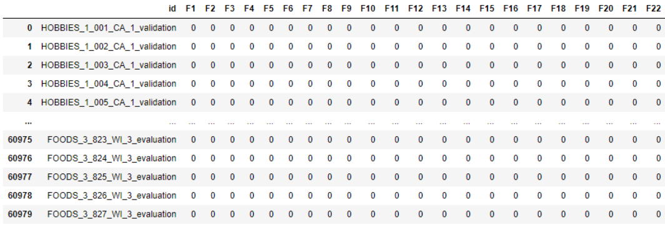
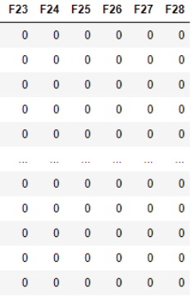

Slide 16




Slide 17




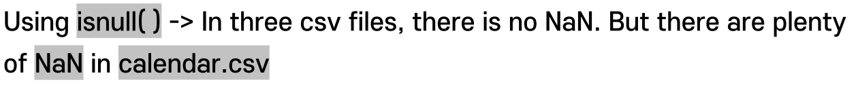

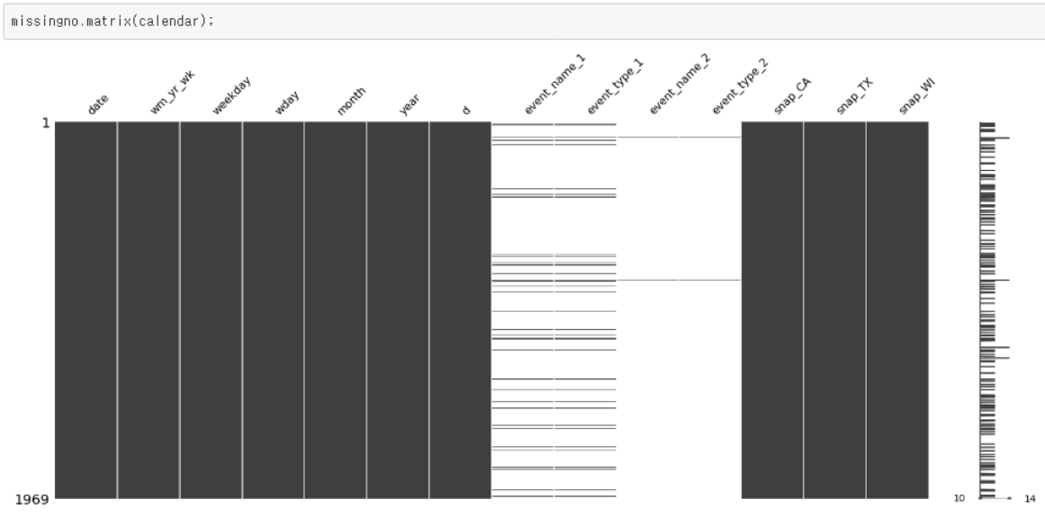
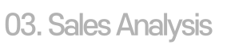


Slide 18
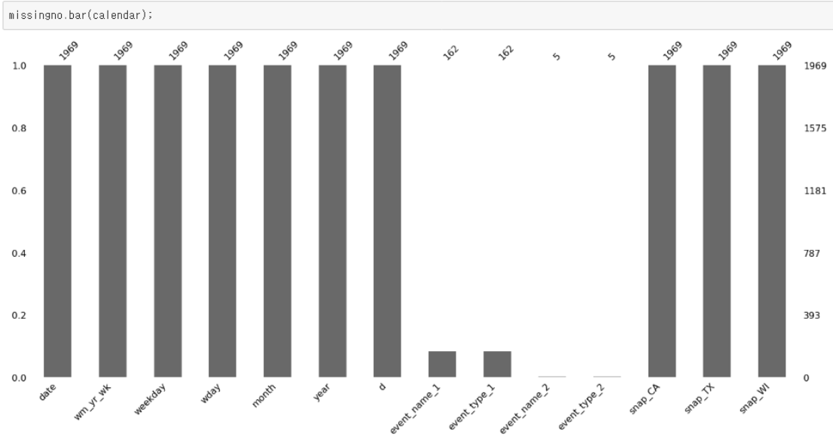

Slide 19
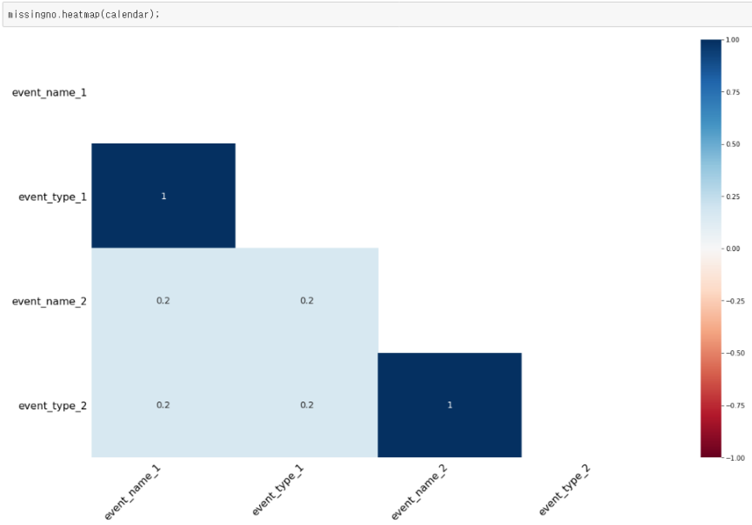

Slide 20





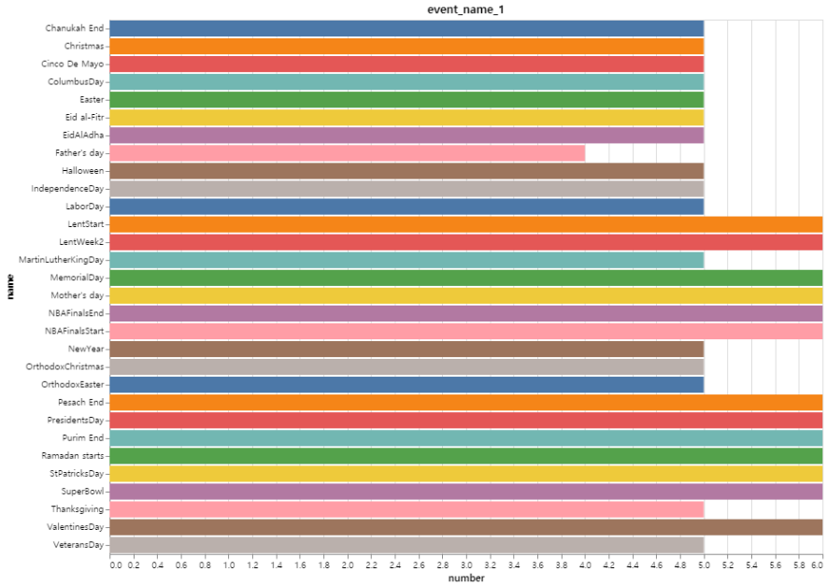

Slide 21

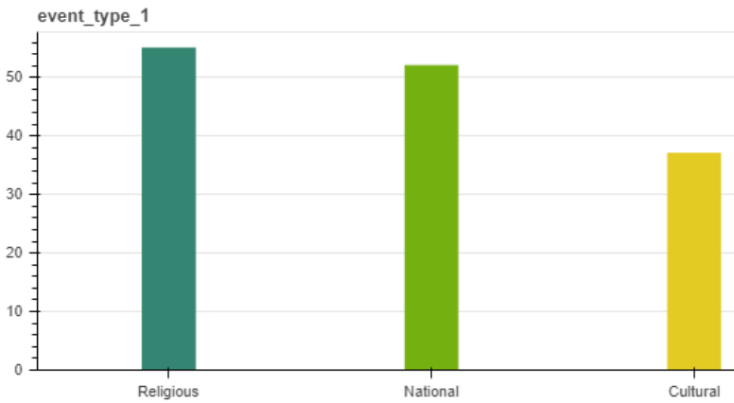
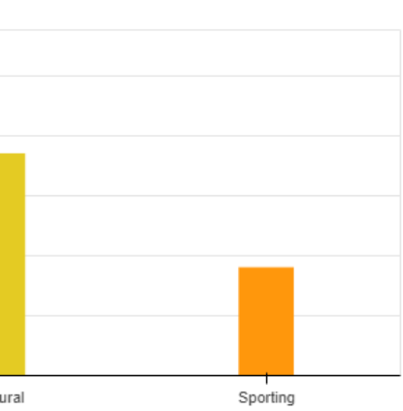

Slide 22
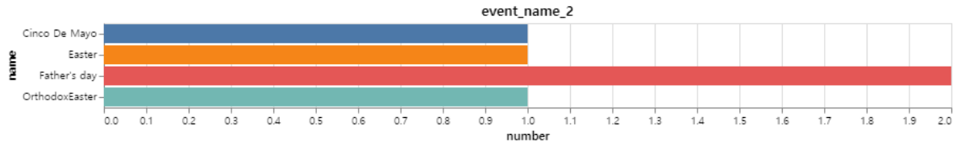
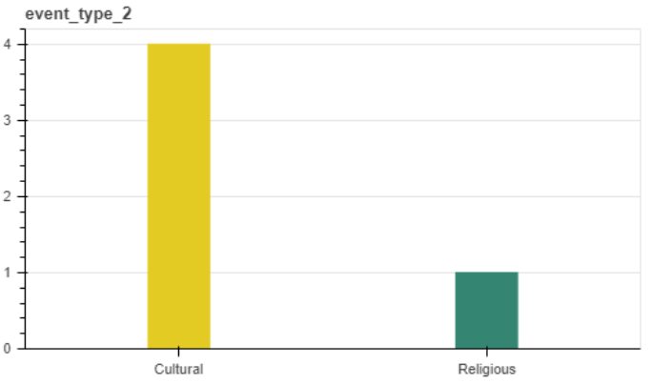

Slide 23
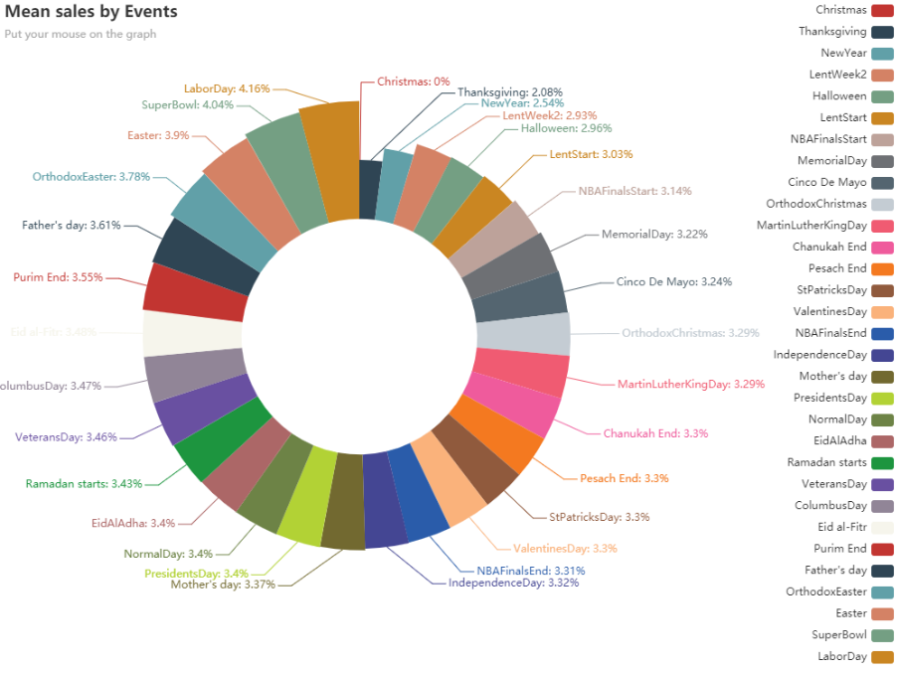
Analyze the sales by event by averaging the total sales of all marts for each event. And compare the average sales of ordinary days.

Slide 24

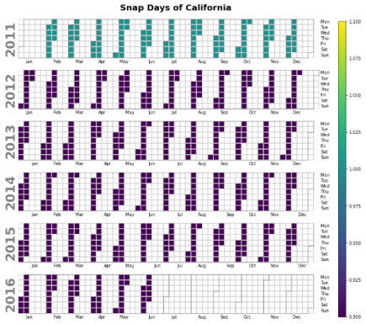
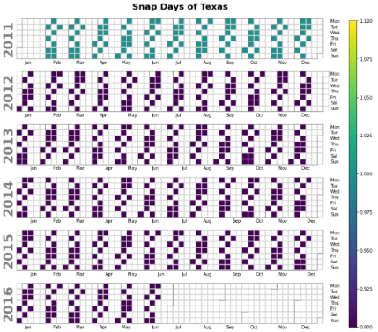
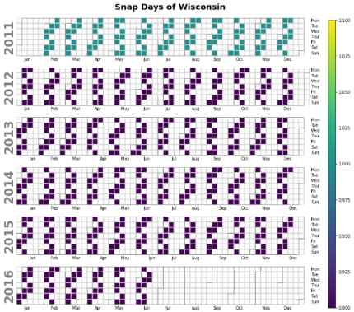
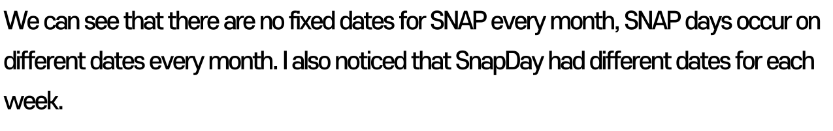

Slide 25


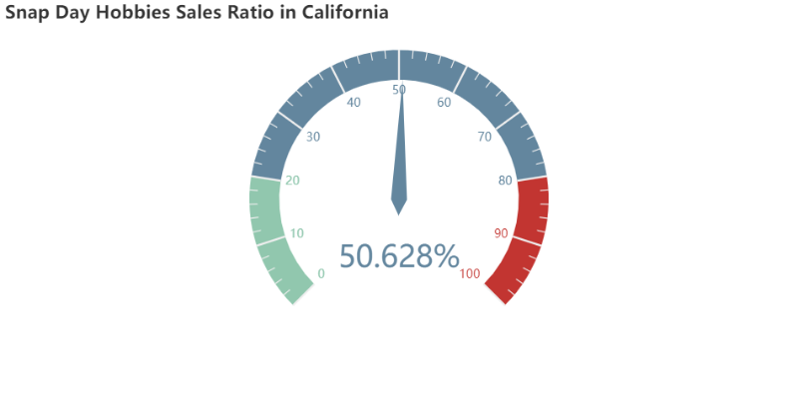
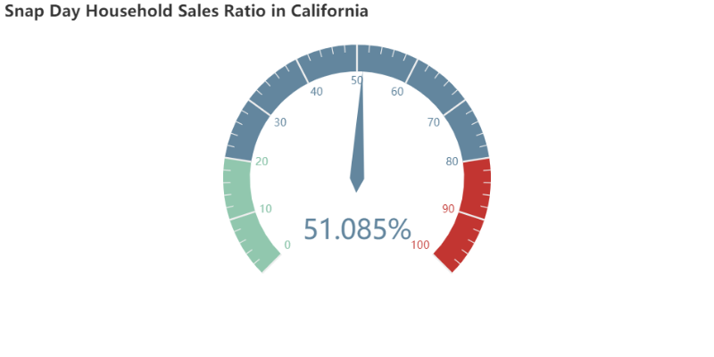




In snap days, there’s different ratio for each category.
Food category has high sales ratio.

Slide 26

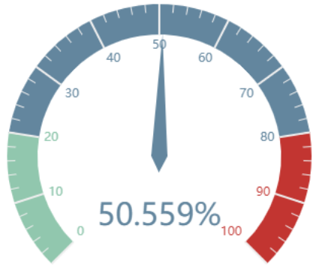
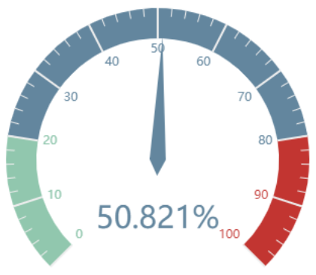
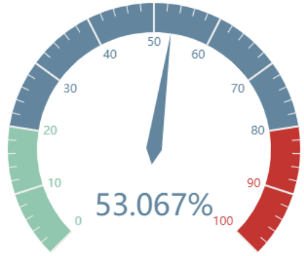
There’s slight difference ratio in each states.

Slide 27

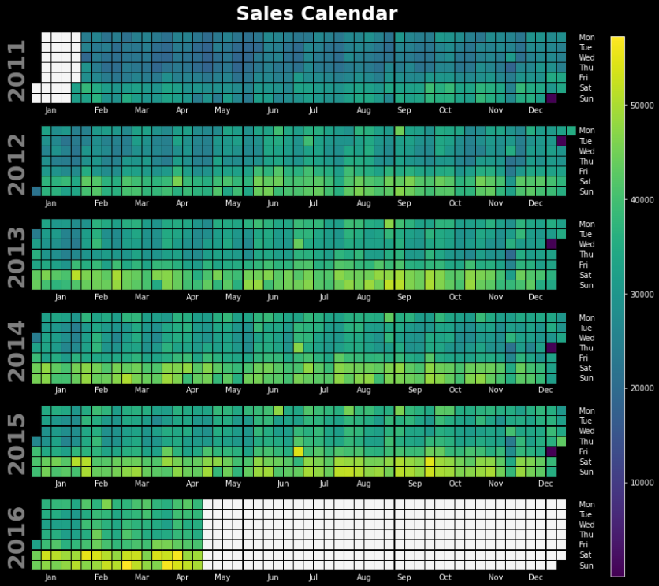

Walmart is apparently closed in Christmas.
Overall sales are relatively high on weekends in comparison weekdays.

Slide 28

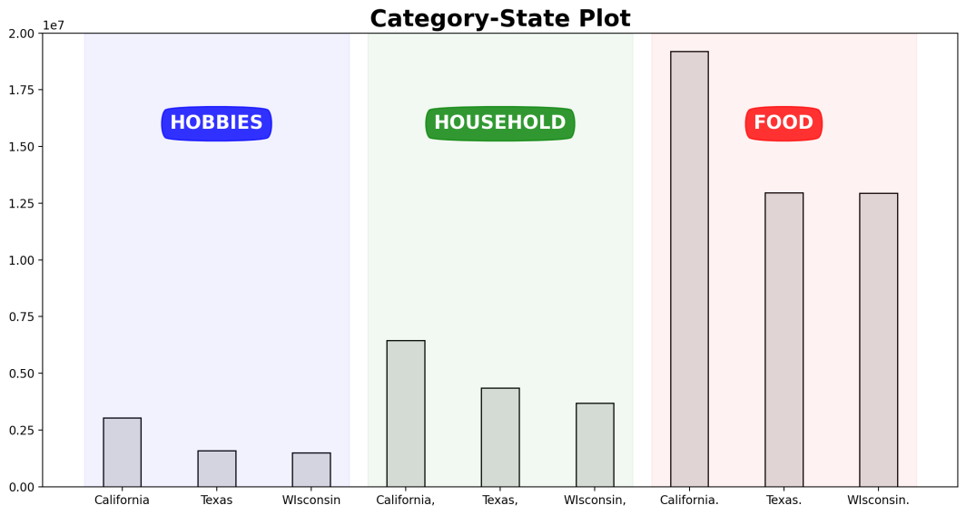
Visualized it to see how many products in each category are sold every three states. There was no noticeable difference in Texas except for a slightly higher percentage of home-related merchandise sales

Slide 29

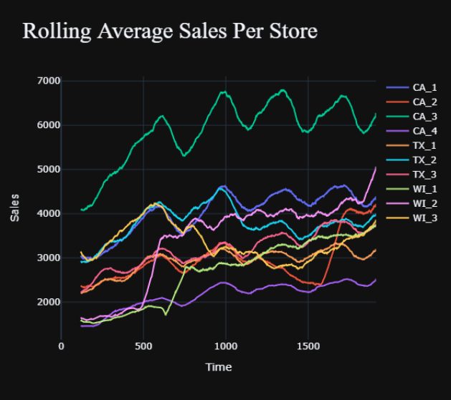
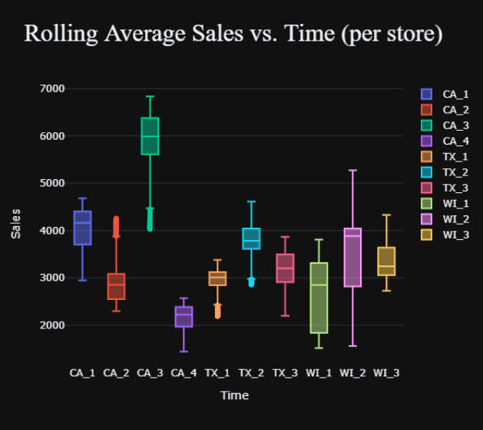
Compared the rolling sales for each store in our dataset. California's 3rd store seems to have the highest mean sales. Wisconsin's first store grew significantly faster from d_500 to d_600 and second store as well from d_600 to d_700. I guess there was big promotion events sequentially in Wisconsin.
Compared the sales distribution for each store in the dataset. CA_1 and CA_4 data are left-skewed. CA_2, WI_3 data are right-skewed. Except the first store of Wisconsin, every store's sales data are not concentrated

Slide 30

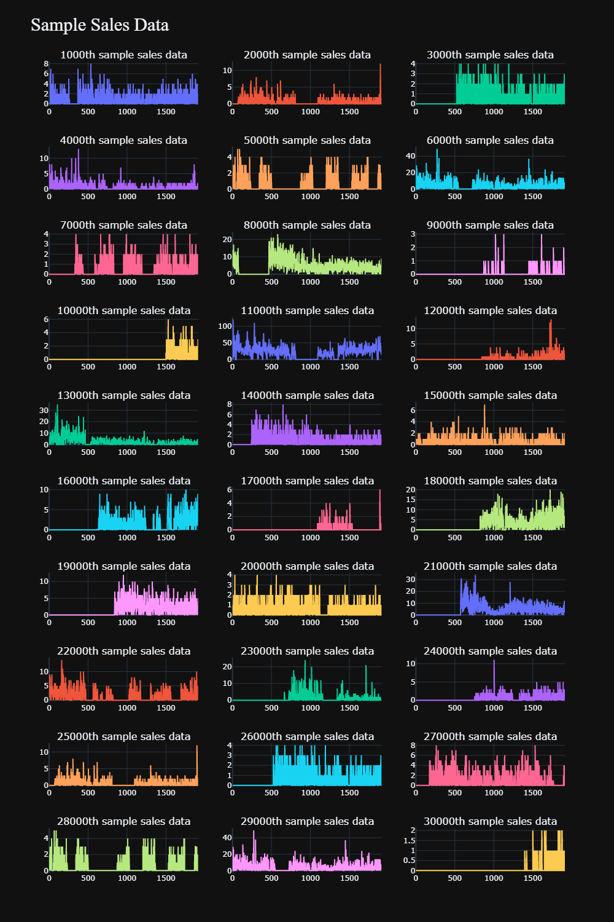

Below plots are very fluctuating, due to the fact that plenty of factors affect the sales on a given day. Even some range of days, the sales quantity is zero. I guess there's out of stock or may not be available due to some reasons

Slide 31


01. Feature Generation
02. Data Memory Reduction

Slide 32



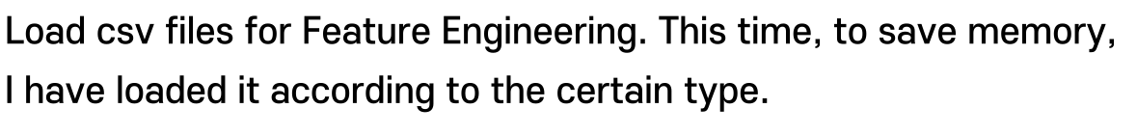
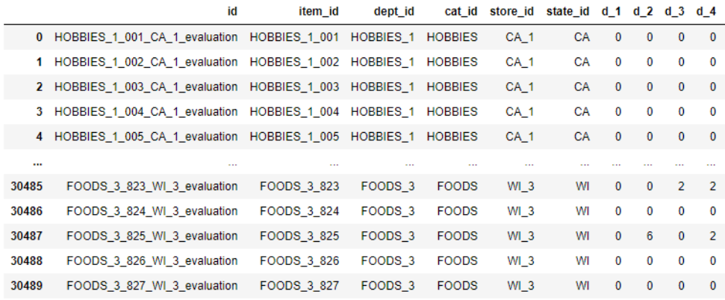
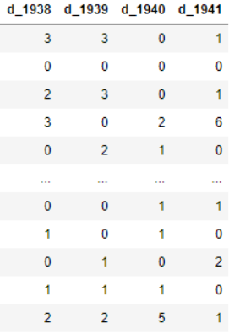
01 Feature Generation
02 Data Memory Reduction

Slide 33

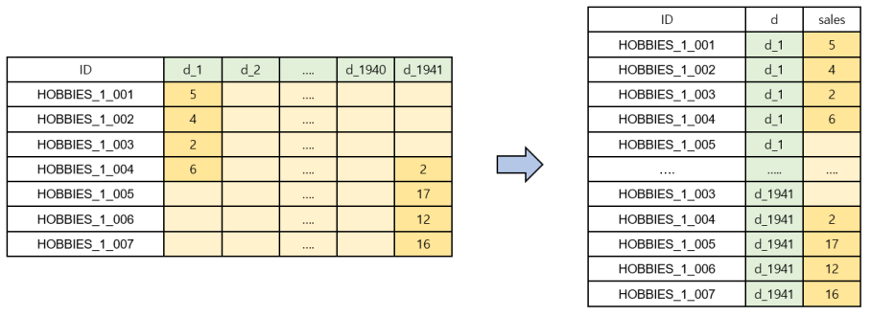
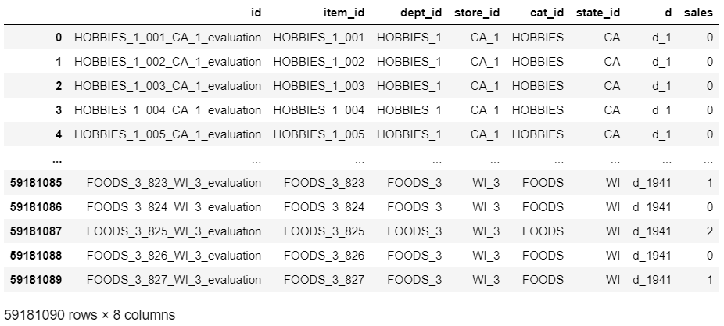
Melted the date column into one column
01 Feature Generation
02 Data Memory Reduction

Slide 34



01 Feature Generation
02 Data Memory Reduction

Slide 35




01 Feature Generation
02 Data Memory Reduction

Slide 36



Created a new column by adjusting the moving average of the price differences of the product by window size.
01 Feature Generation
02 Data Memory Reduction

Slide 37



01 Feature Generation
02 Data Memory Reduction
price
d_1
12
NaN
NaN
d_2
12
mean
NaN
diff
NaN
d_3
6
W=4
NaN
NaN
d_4
6
9
1.5

Slide 38

Created a new column by adjusting the moving average of the price differences of the product by window size.
01 Feature Generation
02 Data Memory Reduction

Slide 39




Created a new column by adjusting the moving average of the sales of the product by window size.
01 Feature Generation
02 Data Memory Reduction

Slide 40


Valid set generation
01 Feature Generation
02 Data Memory Reduction
d_1
d_1
d_1
d_1
d_2
d_2
d_2
d_2
d_3
Model
d_3
d_3
d_3
…
…
…
…
d_1911
d_1911
Model
d_1911
d_1911
d_1912
d_1912
d_1912
Model
d_1912
d_1913
d_1913
d_1913
d_1913
d_1914
d_1914
d_1914
d_1915
d_1915
Public
Score
…
Recursive Prediction Model
d_1941

Slide 41

01 Feature Generation
02 Data Memory Reduction
d_1
d_1
d_1
d_1
d_2
d_2
d_2
d_2
d_3
Model
d_3
d_3
d_3
…
…
…
…
d_1939
d_1939
Model
d_1939
d_1939
d_1940
d_1940
d_1940
Model
d_1940
d_1941
d_1941
d_1941
d_1941
d_1942
d_1942
d_1942
d_1943
d_1943
Private Score
…
Recursive Prediction Model
d_1969

Slide 42



By changing the type to use fewer bytes through the astype() of numpy, I can save memory. The less bytes I use, the less range I can express, so I reduced the memory by checking the minimum and maximum values of the data I are dealing with.
01 Feature Generation
02 Data Memory
Reduction

Slide 43


01 Feature Generation
02 Data Memory
Reduction

Slide 44




Slide 45








5000th, 10000th, 15000th, 25000th samples are selected for Visualization

Slide 46








Slide 47






Slide 48







Slide 49





The main components of the Prophet model are Trend, Seasonality, and Holiday

Slide 50




AutoRegressive Integrated Moving Average (ARIMA) is a combination of an autoregressive model (AR) and a moving averagemodel (MA) and a difference (I) to ensure the normality of data. For ARIMA (1,1,1), this means that AR(1) and I(1), MA(1) are combined models.

Slide 51



Slide 52





Objective : Tweedie

Slide 53

Loss Function : RMSE (root mean squared error)
By minimizing RMSE, we can get high score in LB (LeaderBoard)
We can set loss function by setting tree model’s metric as ‘rmse’

Slide 54


Early Stopping : Custom metric WRMSSE
For my tree modeling LightGBM, XGBosst, I made custom metric for early-stopping to avoid overfitting

Slide 55
Early Stopping : Custom metric WRMSSE
If early_stopping_rounds == 3:
Training
Iteration
100th
101th
102th
103th
104th
105th
105th
106th
wrmsse
0.60
0.58
0.57
0.56
0.57
0.58
0.60
0.62
For my tree modeling LightGBM, XGBosst, I made custom metric for early-stopping to avoid overfitting

Slide 56
Early Stopping : Custom metric WRMSSE
If early_stopping_rounds == 3:
Training
Iteration
100th
101th
102th
103th
104th
105th
105th
106th
wrmsse
0.60
0.58
0.57
0.56
0.57
0.58
0.60
0.62
Training Stop
For my tree modeling LightGBM, XGBosst, I made custom metric for early-stopping to avoid overfitting

Slide 57





Slide 58




Slide 59




Slide 60


Best Hyperparameters
Training with Best HP
'boosting_type': 'gbdt’,
'objective': 'tweedie’,
'metric': 'rmse’,
'verbose': -1,
'boost_from_average': False,
'n_estimators': 5000
'learning_rate': 0.018770362054402065,
'tweedie_variance_power': 1.0527349836416215,
'num_leaves': 1899,
'min_data_in_leaf': 3718,
'max_bin': 337,
'feature_fraction': 0.4037791062361256

Slide 61

Evaluation

Slide 62




Slide 63





Slide 64





Slide 65



Slide 66



Slide 67



Slide 68



Slide 69


d_1
d_1
d_1
d_1
d_2
d_2
d_2
d_2
d_3
LGB Model
d_3
d_3
d_3
…
…
…
…
d_1939
d_1939
LGB Model
d_1939
d_1939
d_1940
d_1940
d_1940
LGB Model
d_1940
d_1941
d_1941
d_1941
d_1941
d_1942
d_1942
d_1942
d_1943
d_1943
Private Score
…
Recursive Prediction Model
d_1969

Slide 70



Slide 71



Slide 72




Slide 73

Best Hyperparameters
Training with Best HP
'objective': 'reg:tweedie',
‘max_bin': 16,
'tree_method': 'gpu_hist’,
'gpu_id': 0
'tweedie_variance_power': 1.1009005809523253,
'learning_rate': 0.1124357654715222,
'max_depth': 11,
'colsample_bytree': 0.41174157144768747,
'colsample_bylevel': 0.2903984415974088,
'gamma': 0.6202372226587107

Slide 74

Evaluation

Slide 75




Slide 76





Slide 77





Slide 78



Slide 79



Slide 80



Slide 81



Slide 82

d_1
d_1
d_1
d_1
d_2
d_2
d_2
d_2
d_3
XGB Model
d_3
d_3
d_3
…
…
…
…
d_1939
d_1939
XGB Model
d_1939
d_1939
d_1940
d_1940
d_1940
XGB Model
d_1940
d_1941
d_1941
d_1941
d_1941
d_1942
d_1942
d_1942
d_1943
d_1943
Private Score
…
Recursive Prediction Model
d_1969

Slide 83




Slide 84




Model
Public LB
Simple Moving Average
1.09
Simple Exponential Smoothing
1.20
TS Model
Double Exponential Smoothing
1.11
Prophet
1.89
ARIMA
1.54
AutoLGB
0.662
DT Model
LightGBM
0.579
XGBoost
0.634
RNN
0.823
NN Model
LSTM
0.762
Ensemble
0.531

Slide 85

To get the advantages of each model, we gave custom weight to models.
SMA
DES
LGB
XGB
LB(public)
0.2
0.2
0.3
0.3
0.973
0.15
0.15
0.4
0.3
0.896
0.15
0.15
0.5
0.2
0.864
0.1
0.1
0.6
0.2
0.744
0.1
0.1
0.8
0.0
0.582
0.1
0.1
0.7
0.1
0.531

Slide 86

To get the advantages of each model, we gave custom weight to models.
Simple Moving
Average (SMA)
Double Exponential Smoothing (DES)
Light Gradient
Boosting Machine (LGB)
Extreme Gradient Boosting (XGB)
0.1
0.1
0.7
0.1
Final Model

Slide 87



Slide 88



Slide 89















